Slide 1

Challenges and Limitations Faced by Companies in Adopting DevOps
Submitted to:
Dr. Murat Ozer
By
Mohan Rajesh Penkey
(m15176471)

Slide 2
Agenda:
Abstract
Introduction
Significance
Problem Statement
Research Questions
Review of Literature
Design and Methodology
Challenges In Adopting DevOps
Limitations in Adopting DevOps
Conclusion

Slide 3
Abstract:
Obstacles in DevOps Implementation:
- Resistance to change
- Lack of skilled staff
- Cultural issues and a dearth of automated solutions
Strategies to Overcome Challenges:
- Develop a well-organized implementation strategy and plan
- Provide staff training and development
- Foster a culture of experimentation and cooperation
Enhancing DevOps Efficiency:
- Leverage automation tools for accelerated procedures
- Boost software development effectiveness and speed
- Attain a competitive advantage in the market

Slide 4
Introduction:
"Enhanced software project development is facilitated by a shift in methodologies, fostering consistency and teamwork. Integrating DevOps and digital technologies enables efficient delivery of quality hardware and software, overcoming obstacles and creating economic opportunities. DevOps, a set of cultural norms, streamlines collaboration between development and operational teams, ensuring on-time delivery with improved quality. This paradigm mix enhances engagement with IT staff, fostering greater interaction and cooperation."

Slide 5
Significance:
The challenges and limitations companies face in adopting DevOps are significant hurdles that can impact the seamless integration of development and operations processes. Organizational resistance to change, lack of skilled personnel, and legacy systems are common impediments. Resistance often arises due to cultural shifts required for collaboration and continuous improvement. Moreover, the need for more skilled professionals with expertise in development and operations can hinder the implementation of DevOps practices. Legacy systems pose compatibility issues, making it difficult to achieve the desired level of automation and efficiency. Overcoming these challenges is crucial for companies to fully leverage the benefits of DevOps, including faster development cycles, improved collaboration, and enhanced software delivery.

Slide 6
Problem Statement:
The adoption of DevOps in small companies is often hindered by several challenges and limitations. Limited financial resources pose a significant hurdle, as implementing DevOps practices requires investments in tools, training, and infrastructure. Additionally, the cultural shift towards collaboration and automation can be met with resistance from established workflows and traditional mindsets. Small teams may also struggle with finding the right talent with expertise in both development and operations, making skill acquisition a key obstacle. Furthermore, the complexity of integrating DevOps into existing systems and processes can result in disruptions and downtime, deterring some organizations from fully embracing this transformative approach. Overall, overcoming these challenges necessitates a strategic and phased approach tailored to the unique circumstances of small companies.

Slide 7
Research Questions:
What challenges do companies face when striving to implement continuous production and continuous deployment within the framework of DevOps?
How can businesses effectively surmount the hindrances associated with integrating DevOps into a rapid methodology?

Slide 8
Review of Literature:
DevOps, a collaborative approach merging operations and software development, promotes teamwork and rapid software releases. Originating from a mindset fostering collaboration within IT, it extends agile principles, emphasizing continuous integration and automation to minimize release delays. This strategy enhances communication, ensuring swift software delivery, frequent updates, and heightened reliability. DevOps improves efficiency, productivity, and product quality, leading to increased client satisfaction. By breaking down silos and encouraging a unified team approach, it streamlines integration across all product development stages, allowing software organizations to deliver features and enhance products more swiftly based on continuous feedback.

Slide 9
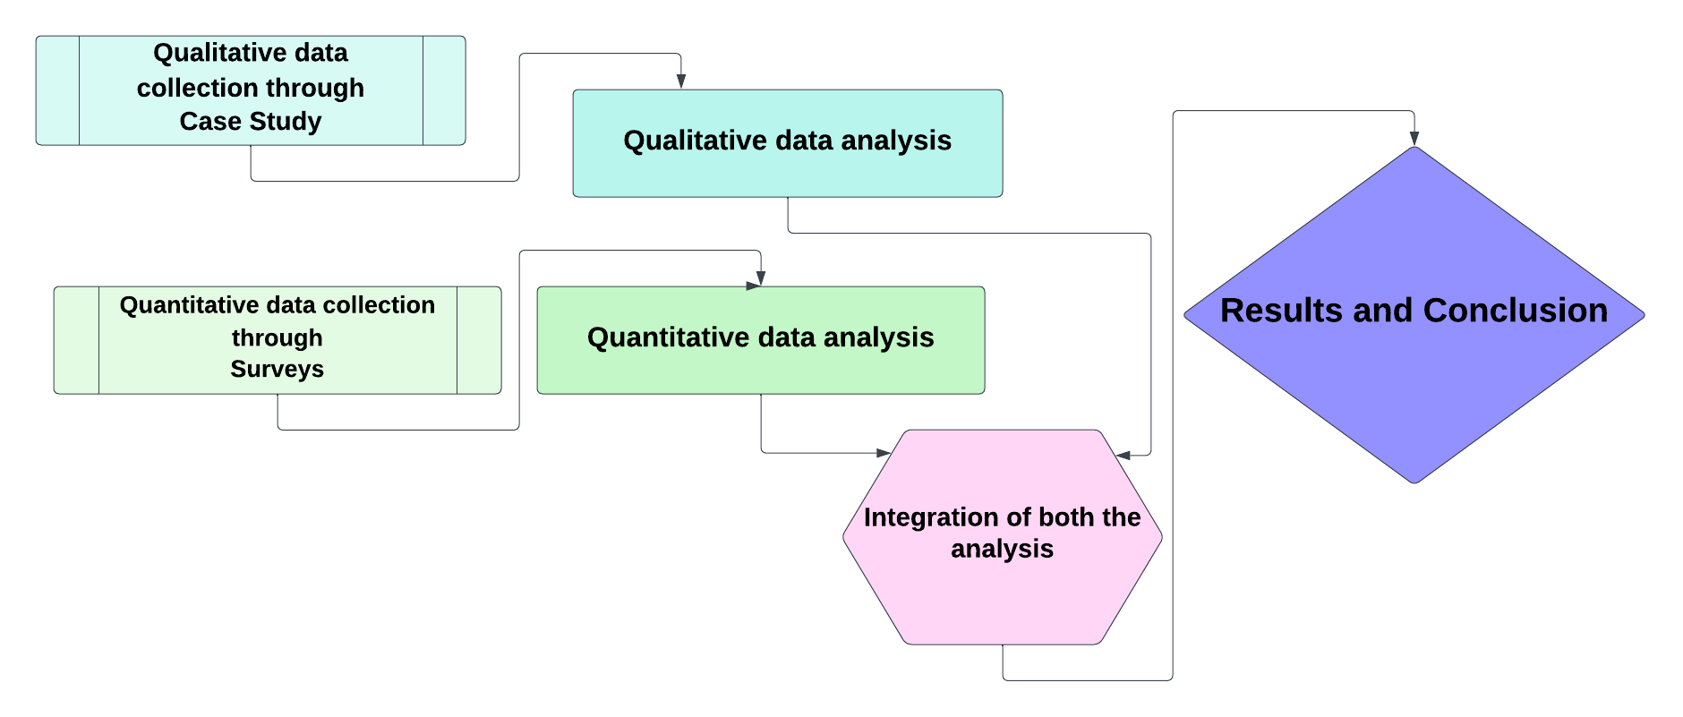
Design and Methodology:
The research methodology adopted for this study is characterized by a thoughtful integration of both qualitative and quantitative data collection techniques. As highlighted by Hafsa (2019), this strategic combination serves to harness the strengths of each method while offsetting their limitations. To capture qualitative insights, a survey strategy is employed, providing a nuanced understanding of the subject under investigation. Concurrently, quantitative data is garnered through the insightful lens of case studies. This dual approach proves particularly advantageous when delving into the real-time implementation of DevOps in organizational settings, allowing for a comprehensive examination. The use of case studies enhances the depth of exploration, enabling meaningful comparisons with the qualitative findings and contributing to a more robust analysis.

Slide 10
Design and Methodology:
Data acquisition employs both qualitative and quantitative methodologies. The quantitative approach, in this case, utilized a survey to gather information. The questionnaire, strategically designed to address challenges and solutions in DevOps deployment, was administered online. This survey proved instrumental in comprehending strategies to overcome obstacles in the deployment of DevOps. To quantify the collected data, a set of closed-ended survey questions was employed. The data collection process adhered to a 5-scale Likert scale, providing a structured framework to assess and measure the gathered insights.
It was strategically decided to use a convenience sampling technique for the survey, which involved selecting participants who were easily reachable. This approach was selected to maximize information-gathering efficiency because it was both highly efficient and cost-effective in terms of the amount of time needed to collect data. The research team sought to improve the overall feasibility and usefulness of the study by streamlining the survey process and explicitly selecting individuals who were more accessible. The size of the population that was used is 50.
In the case study, the data analysis procedure went beyond simple numerical examination. It entailed a careful examination of the difficulties that DevOps and different businesses faced. This in-depth analysis sought to uncover the complex challenges present in these domains. Moreover, the examination expertly combined a range of options designed to deal with and settle the problems found. Essentially, the data analysis explored the qualitative aspects in addition to the quantitative ones, promoting a comprehensive comprehension of the issues and solutions.

Slide 11
Challenges in Adopting DevOps:
Adopting DevOps, the collaborative culture that integrates development and operations teams to enhance software delivery, is challenging. One significant hurdle is the cultural shift required to break down silos and foster open communication between traditionally separate departments. Resistance to change from both development and operations teams can impede progress, as individuals may be accustomed to established workflows and practices.
Implementing automation tools, a key aspect of DevOps also poses difficulties as organizations need to invest in and adapt to new technologies. Additionally, measuring the success of DevOps initiatives and aligning them with business objectives can be complex, requiring the development of metrics and key performance indicators that accurately reflect the overall impact on software delivery and operational efficiency. Successful adoption of DevOps necessitates a holistic approach addressing both cultural and technical aspects, often requiring a gradual transition and ongoing commitment to continuous improvement.
Moreover, security concerns represent a critical challenge in DevOps adoption. Integrating security into the development process, DevSecOps is essential but often challenging. Balancing the need for speed and agility with robust security measures can be a delicate act, and organizations must implement security practices throughout the entire software development lifecycle to mitigate risks effectively. Furthermore, skill gaps and the need for continuous training pose additional hurdles.

Slide 12
Limitations in Adopting DevOps:
The adoption of DevOps, while promising significant benefits in terms of accelerated development cycles, enhanced collaboration, and improved software quality, is not without its challenges and limitations. One major hurdle is the cultural shift required within organizations, as DevOps necessitates a fundamental change in mindset and work practices.
Resistance to change from established silos, lack of communication between development and operations teams, and ingrained traditional workflows can impede successful implementation. Additionally, legacy infrastructure and applications may not seamlessly align with DevOps practices, requiring substantial time and resources for integration. Security concerns also arise, as the rapid deployment characteristic of DevOps can potentially introduce vulnerabilities if not adequately addressed. Successfully navigating these limitations demands a holistic approach that combines technological advancements with organizational and cultural adaptations.

Slide 13
Conclusion:
DevOps approach implementation in enterprises is a challenging endeavor that calls for a significant change in technology, procedures, and culture. During the implementation phase, issues like cultural obstacles, resistance to change, a lack of experienced workers, and a lack of automated solutions could come up. Organizations can begin addressing these problems by creating a clear plan and strategy for DevOps adoption and highlighting its advantages to pertinent stakeholders. It's imperative to spend money on employee upskilling and training to make sure workers can apply DevOps techniques efficiently. In addition, a DevOps methodology cannot be successfully implemented without cultivating a culture of experimentation, continuous development, and cooperation. Finally, using automation tools can improve overall productivity and streamline procedures.

Slide 14
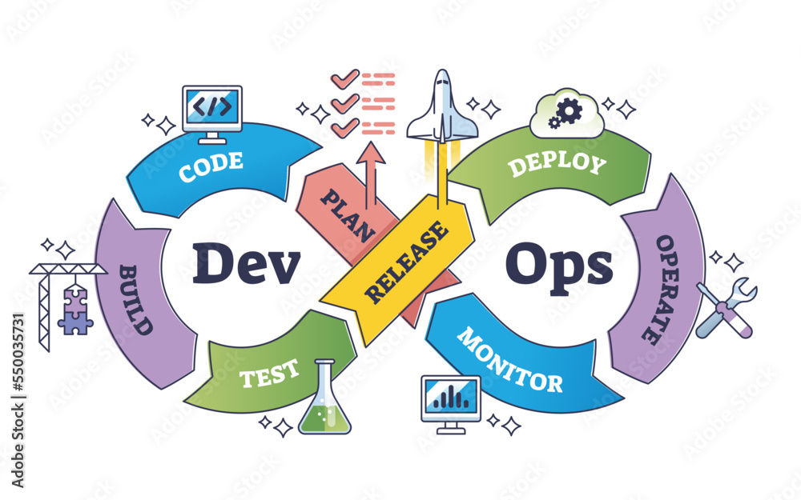
THANK YOU

